Slide 1

Rock identification Using deep convolution neural network
Smart Bridge-Remote Summer Internship Program
Team Name: Hash It Out
Team Members:
Ravula Karthik Reddy
Mohammed Farha Nousheen
Madiha Razeen

Slide 2
TABLE OF CONTENTS
Introduction
Overview
Purpose
Block diagram
Flow Chart
Software Analysis
Advantages & Disadvantages
Conclusion

Slide 3
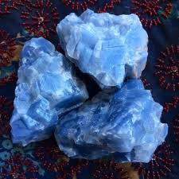
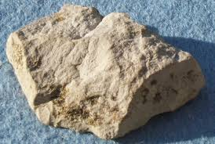
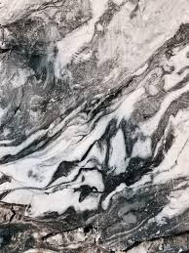
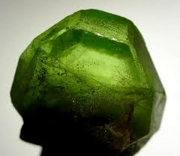
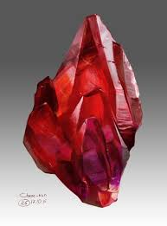
INTRODUCTION
In the mining process of underground metal mines, the misjudgement of rock types by on-site technicians will have a serious negative impact on the stability evaluation of rock mass and the formulation of support schemes, which will result in the loss of economic benefits and potential safety hazards of mining enterprise.
In order to realize the precise and
intelligent identification of rock
types, the image data of blue calcite,
limestone, marble, olivine, red crystal,
are amplified.

Slide 4
OVERVIEW
A tremendous interest in deep learning has emerged in recent years. The most established algorithm among various deep learning models is convolutional neural networks that has been a dominant method in computer vision tasks since the astonishing results were shared on the object recognition.
Geological research is no exception, as CNN has achieved expert-level performances in various fields.
Needless to say, there has been a surge of interest in the potential of CNN among geological researchers, and several studies have already been published in areas such as mineral detection using satellite images, classification of geographical terrains, image reconstruction of ocean bed and unreachable places, etc.

Slide 5
PURPOSE
This projects presents a framework for classifying multiple rock structures based on the geological images of tunnel face using convolutional neural networks(CNN).
A prototype recognition system is implemented to classify 5 types of rock structures including of ‘blue calcite’, ‘limestone’, ‘marble’, ‘olivine’, ‘red crystal’.These are the major rock types found in Indian subcontinent.
The experimental results reveal that the proposed method is optimal and efficient for automated classification of rock structure using the geological images of the rocks.

Slide 6


BLOCK DIAGRAM
Multi-Channel EMG Estimated Motor Intent
(a)
Multi-Channel EMG Estimated Motor Intent
(b)
Preprocessing
Segmentation
Feature
Evaluation
Classifier
CNN

Slide 7
Flow Chart

Slide 8




Software Analysis:
Jupyter Notebook Environment
Spyder Ide
Python ()
HTML
Flask

Slide 9
ADVANTAGES AND DISADVANTAGES
Advantages:
The main advantage of CNN compared to its predecessors is that it automatically detects the important features without any human supervision. For example, given many pictures of rocks ,it can learn the key feature for each class by itself.
Disadvantages:
CNN do not encode the position and orientation of object.
Lack of ability to be spatially invariant to the input data.

Slide 10
CONCLUSION
The identification of rocks with the scope of images is possible with Convolution Neural Network. Further data are needed to achieve higher accuracy rates.In the context of our proposed model, we have achieved high classification success without using any method of data augmentation. Studies show that the number of images and classes in the data set can be increased and a more comprehensive recycling project can be realized.

Slide 11
